Slide 1
Machine Learning - Basics

Slide 2



Definition
Machine Learning (ML) is a subset of artificial intelligence that enables systems to learn and improve from experience without being explicitly programmed.
It involves algorithms that can analyze data, learn from it, and make decisions or predictions based on the data
Supervised Learning
Unsupervised Learning
Semi-Supervised Learning
Human
Human
?

Slide 3


How do we learn?
Learning Error → Cost function/Loss function
Correcting your learning → Gradient Descent/Back propagation
Observed data → Train data
Un-observed data → Test data
Cat
?
Observed sample with label
Un-observed data

Slide 4
Linear Regression
Very simple, basic algorithm with multiplication and addition
Classification ??? Regression ????
X ←Observation
y ←Label
X
Weights
Error
Bias
+
Prediction
Parameters
Correction/Gradient Descent

Slide 5
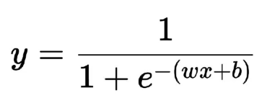
Logistic Regression
Classification Algorithm
X ←Observation
y ←Label
X
Weights
Error
Bias
+
Prediction
Parameters
Correction/Gradient Descent

Slide 6
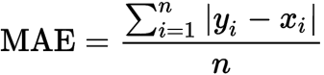
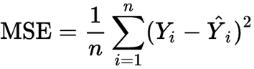
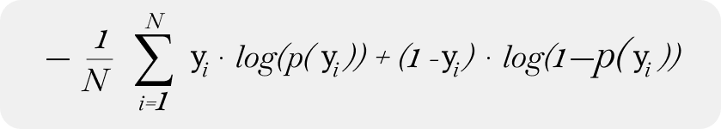
Popular Loss/Error Functions
Mean absolute error
Mean squared error
Cross Entropy Loss
Binary Cross Entropy Loss
Categorical Cross Entropy Loss
https://pytorch.org/docs/stable/nn.html#loss-functions

Slide 7
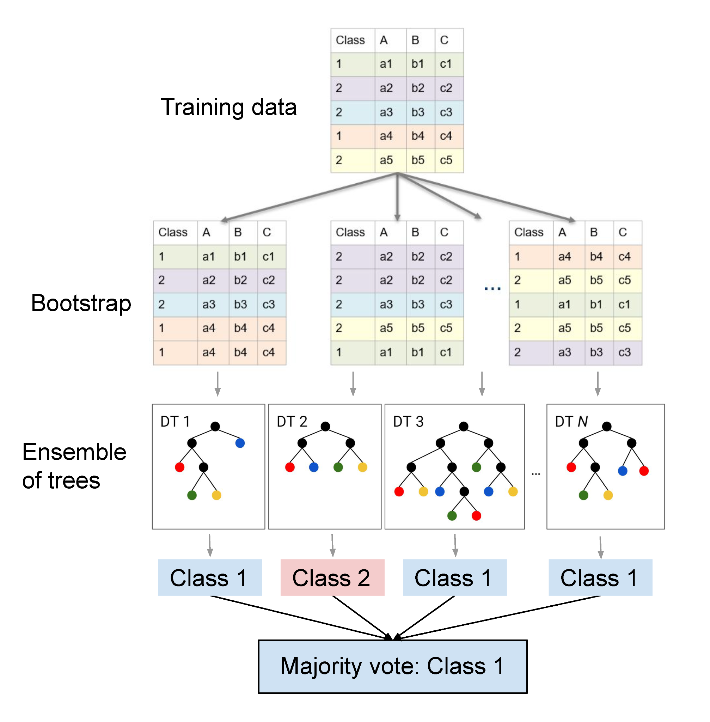
Random Forest
Ensemble of decision trees
Regression and classification
Bootstrap aggregating (Bagging)
Feature randomness
Accuracy, Robustness, Missing Features, Feature importance
Disadvantages: Complexity, Model interpretation
Picture is from: https://pages.cms.hu-berlin.de/EOL/geo_rs/S08_Image_classification2.html

Slide 8
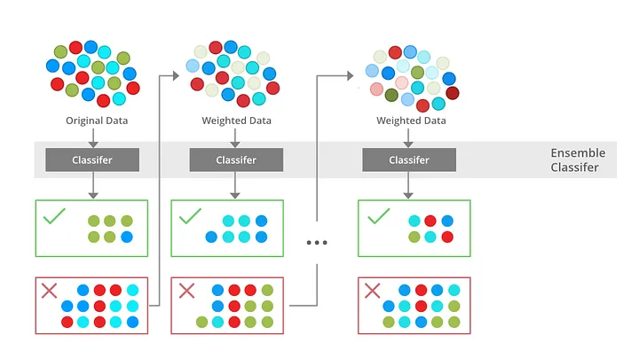
XGBoost
Gradient Boosting Algorithm
An ensemble approach
Decision trees learn from mistake made in previous stage
Combination of Weak Learners→ Strong Learner
Picture is from: https://medium.com/@techynilesh/xgboost-algorithm-explained-in-less-than-5-minutes-b561dcc1ccee

Slide 9
Next Week?
Multi Layer Perceptron -> Tabular, image
-> Tensorflow/keras, Pytorch
Convolution Neural Network -> Tabular, image
-> Tensorflow/keras, Pytorch
Graph Neural Network -> -> Tabular, image
-> Tensorflow/keras, Pytorch

